Slide 1

Program Organization
Self Study

Slide 2


Pointers

Slide 3
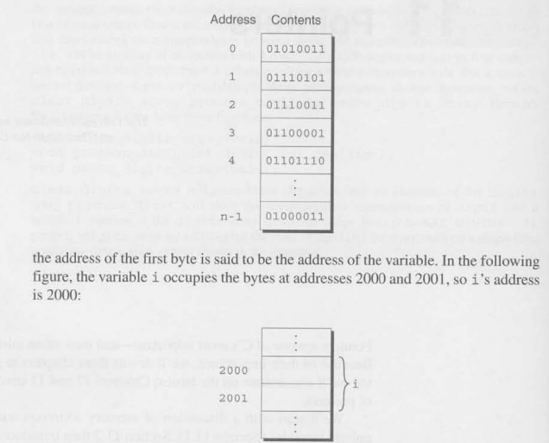
Pointer Variables

Slide 4
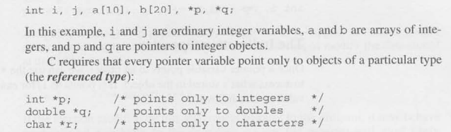
Declaring Pointer Variables

Slide 5
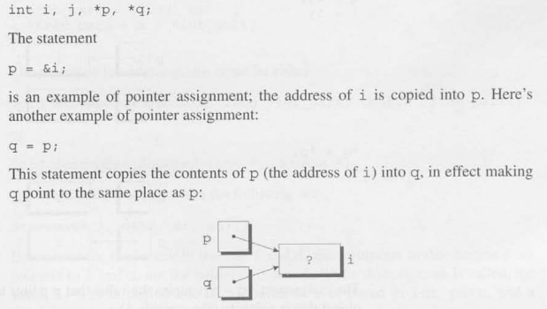
Pointer Assignment

Slide 6
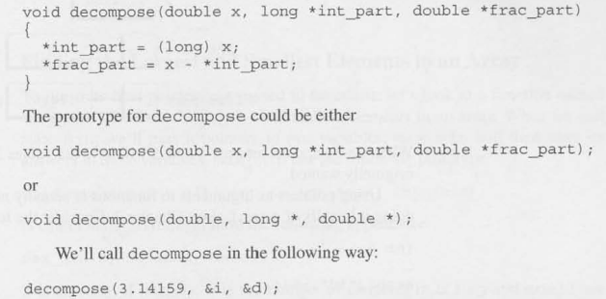
Pointers as Arguments

Slide 7
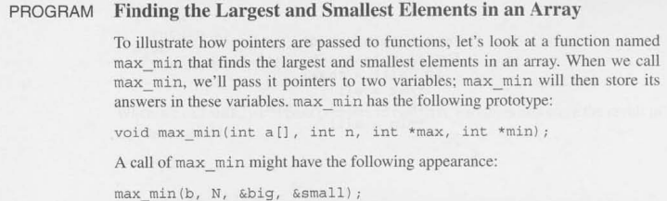

Slide 8

Constant to Protect Argument

Slide 9
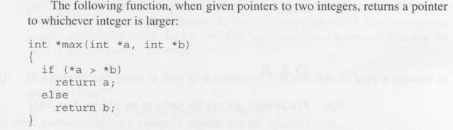
Pointer as Return Values

